Slide 1
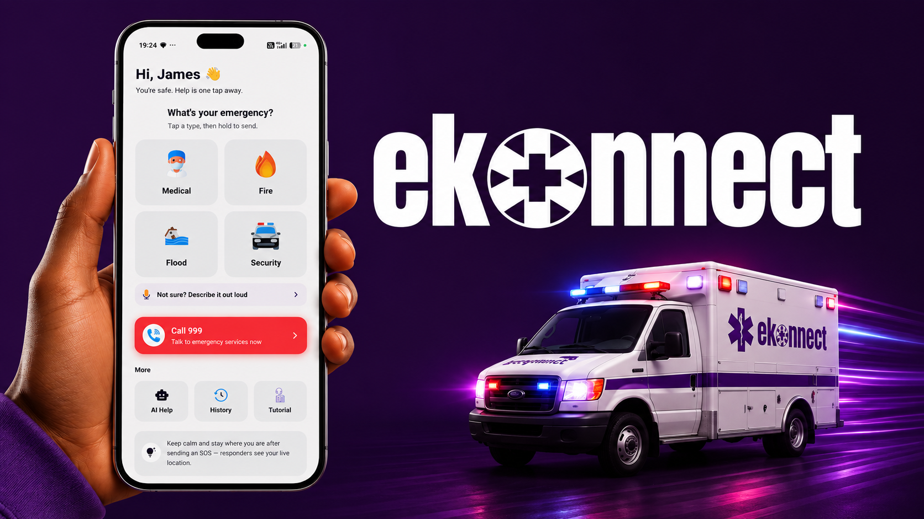

Slide 2
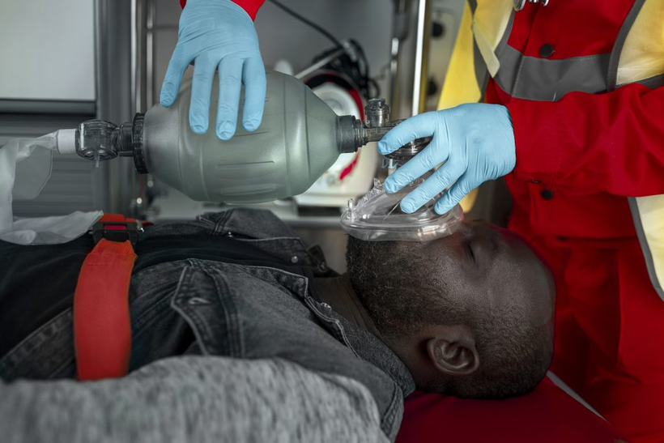
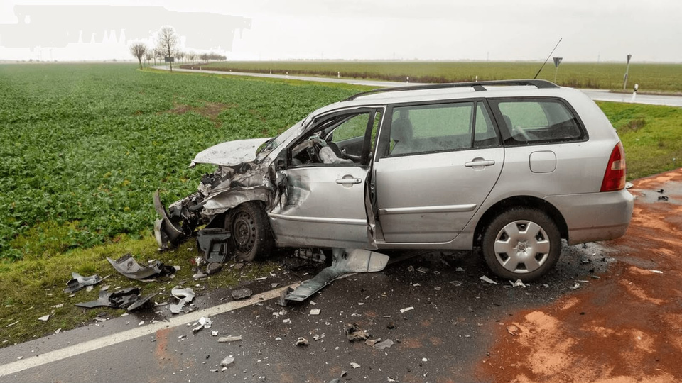
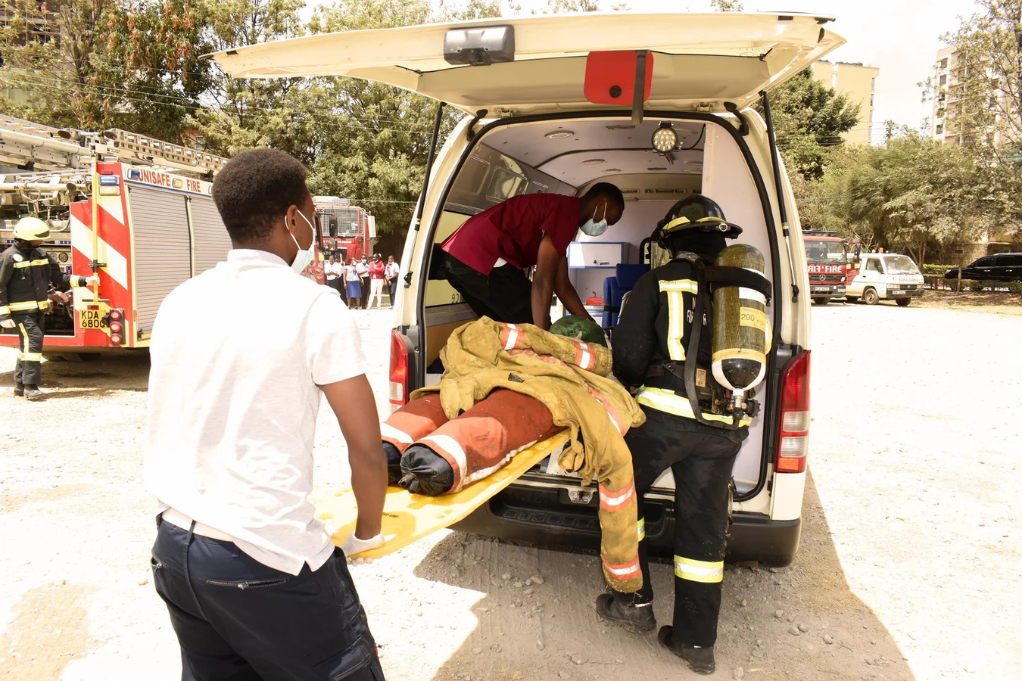
The Problem
Delayed emergency response during the Golden Hour.
Poor coordination among ambulances, hospitals, and first responders.
Difficulty locating the nearest available ambulance.
Lack of a centralized emergency communication platform.

Slide 3
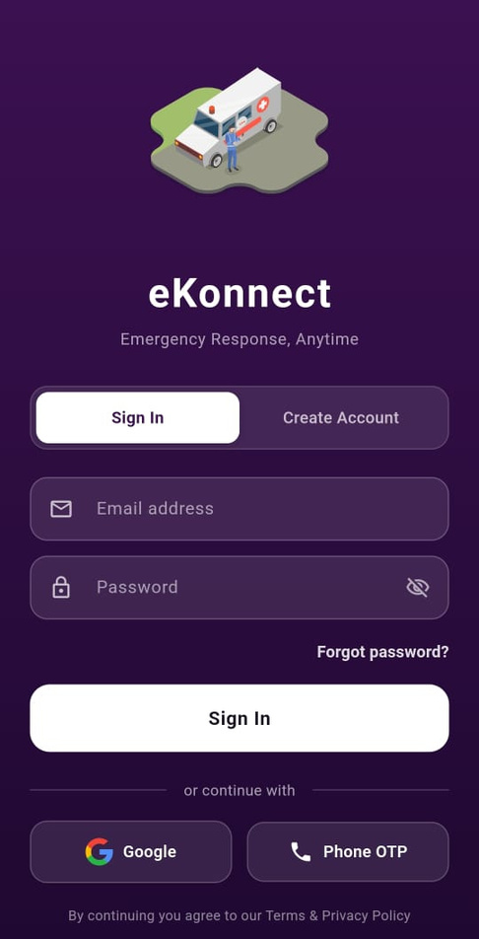
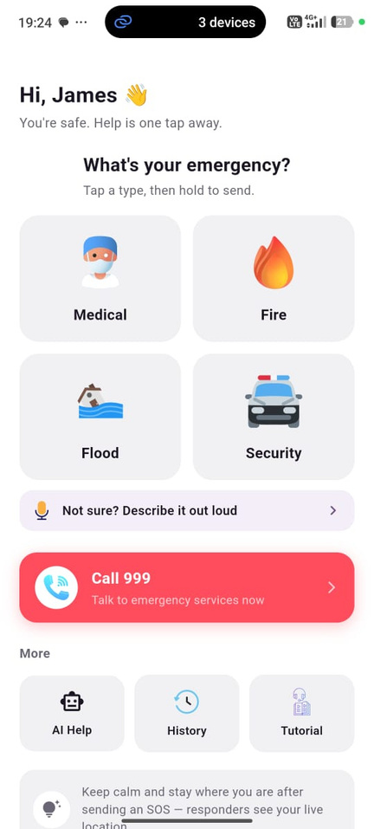
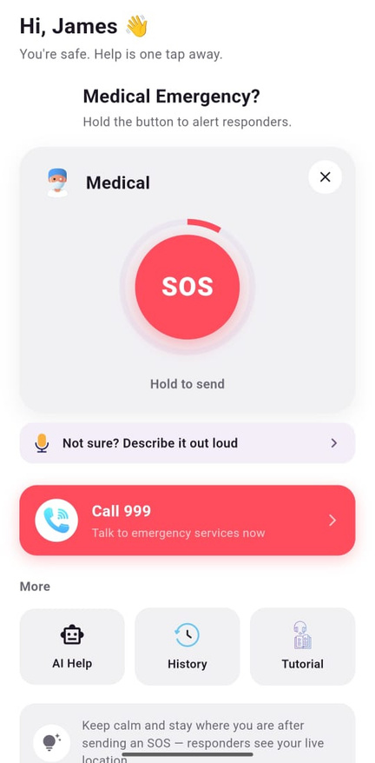
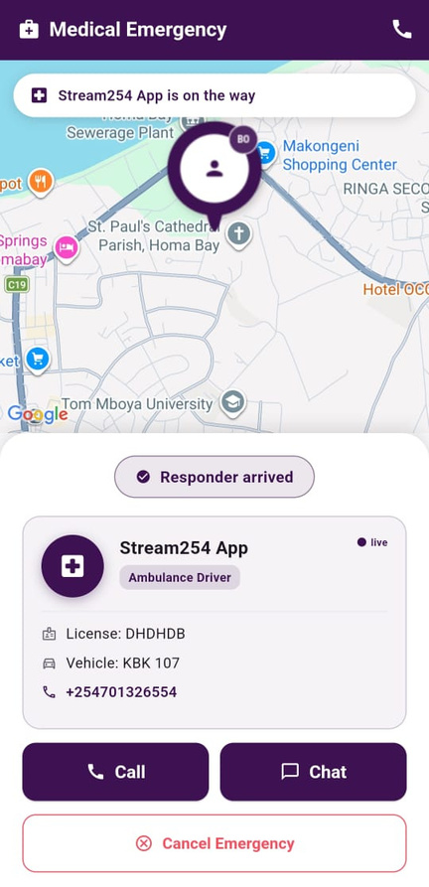
The Patient
Login
Home
SOS
Response

Slide 4
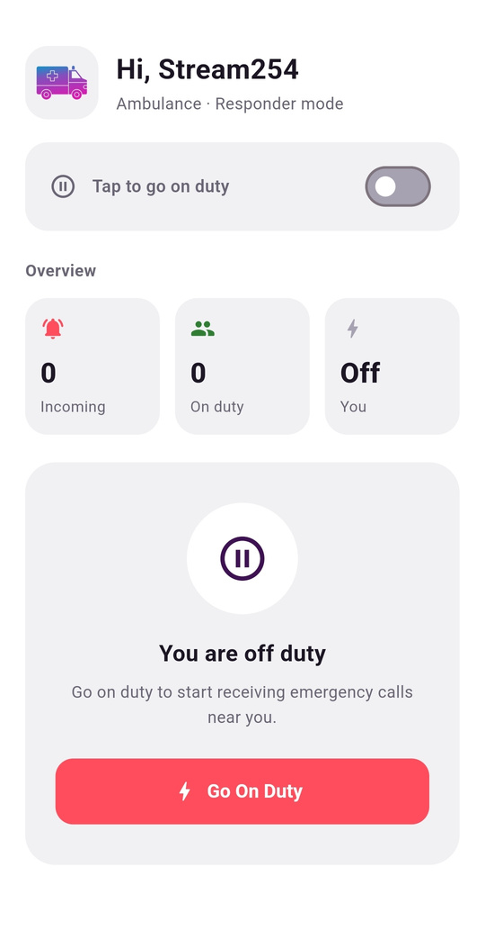
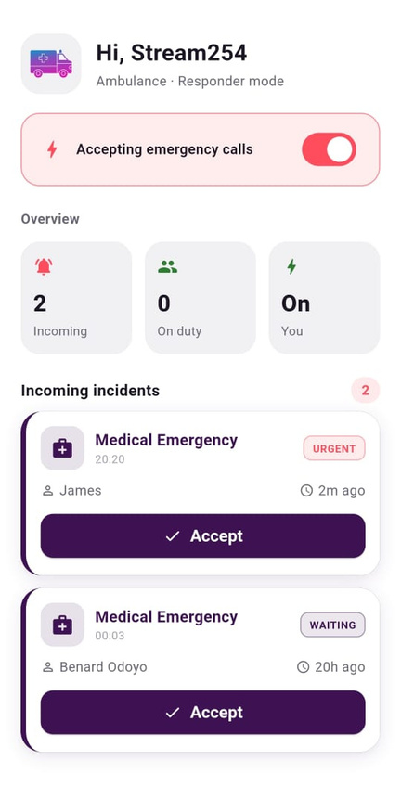
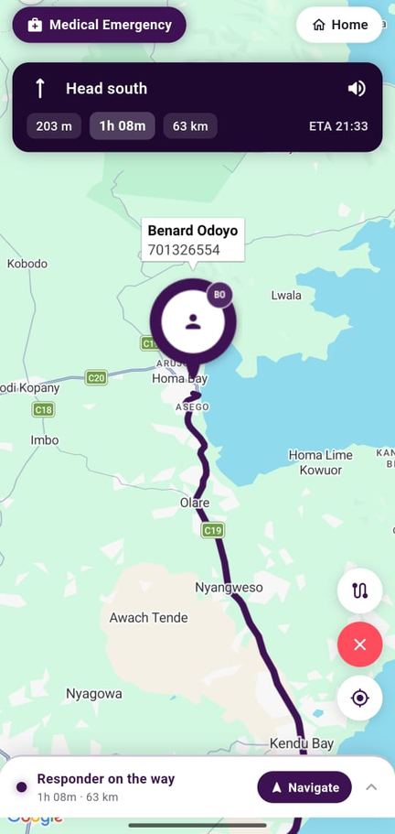
The Responder

Slide 5
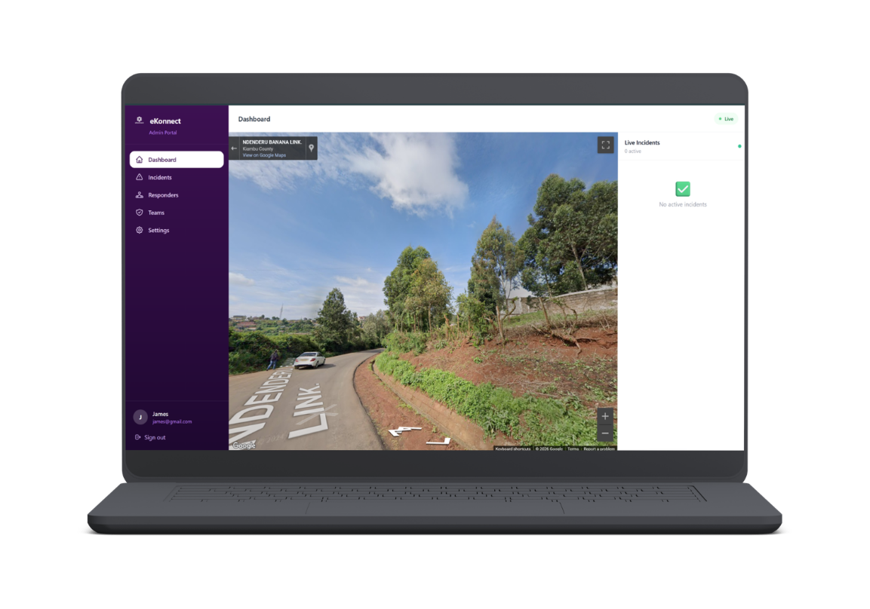
Stakeholder
Stakeholders
Management
Superadmin
Admin
Managers
Supervisors
Employees
Role allocation of management
Coordinate responder and patient
User management
Assign roles
Payments
Verification and Compliance

Slide 6
Unique Value Proposition
Faster emergency response < 20mins
Real-time GPS tracking - with 3D Visualization of the area
Cloud-based infrastructure - scalable and reliable
Support both private and public responders
Secured client information

Slide 7
Execution 5yr Plan
Year1
Year2
Year3
Year4
Year5
3
Regional Growth
Regional Leader
Foundation
Validate
Scale
Launch MVP: patient, responder & admin apps
Pilot in 1 county with a public ambulance partner
Verify and onboard first 50 responders
Close KSH 5.7M seed round
Expand to 3–5 counties
Launch private-provider subscriptions (B2B)
Integrate M-Pesa billing
Reach 5,000 users, 200 verified responders
National rollout to 15+ counties
County government & NGO partnerships
Multilingual AI triage (Swahili & local languages)
Reach operating break-even
Expand to Uganda, Tanzania & Rwanda
Hospital & insurer billing integrations
100,000+ users, 2,000+ responders
eKonnect: East Africa's emergency backbone
SDG impact reporting for government partners
Raise Series A for continued expansion

Slide 8
Ask
KSH 5.7M
S/N | Description | Amnt(Ksh)
1 | Infrastructure and uptime data storage, Cloud hosting with redundancy, real time services and data backup and disaster recovery. | 1.7Million
2 | Data security and compliance - Licensesfor data, compliance. | 500,000
3 | People and operations -training,Change management | 500,000
4 | Project development; app engineering and integration. | 2.0 Million
5 | Contingency | 1 Million
 | Total | 5.7 Million

Slide 9

Expected Outcome
Financial
Impact
3,500+
verified ambulances and practitioners on the network (SDG 9 — Industry, Innovation & Infrastructure)
<20 min
average emergency response time (SDG 3 — Good Health & Well-Being)
250,000+
citizens covered by the public safety net, across 4 countries (SDG 11 — Sustainable Cities & Communities)

Slide 10



Our Team
Januaris Kibet
John Kyalo
PARAMEDIC
PARAMEDIC
MilkahAlbert
healthcare provider
Support
Dr Tecla Sum - Supervisor
Benard Phabian - Software Designer

